Slide 1
25Live, Reservation & Event Policies

Slide 2
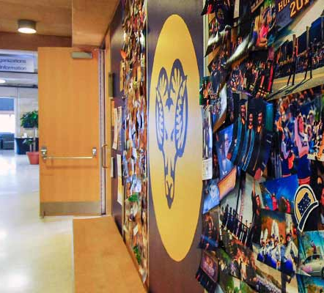

OVERVIEW
Understanding 25Live & Reservation Policies
Learning Objectives
25Live and the Planning Process
Reservation and Event Policies
Points of Contact

Slide 3

DEVELOPING THE PROGRAM
Notes:
Not all clients, but for many it is a very stressful process

Slide 4

Developing the Program
Understanding University Policy
Program Planning Guide
Policies Related to Space:
Reservations
Fundraising
Parties
Food

Slide 5
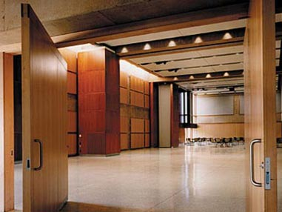
RESERVING SPACE FOR PROGRAM

Slide 6
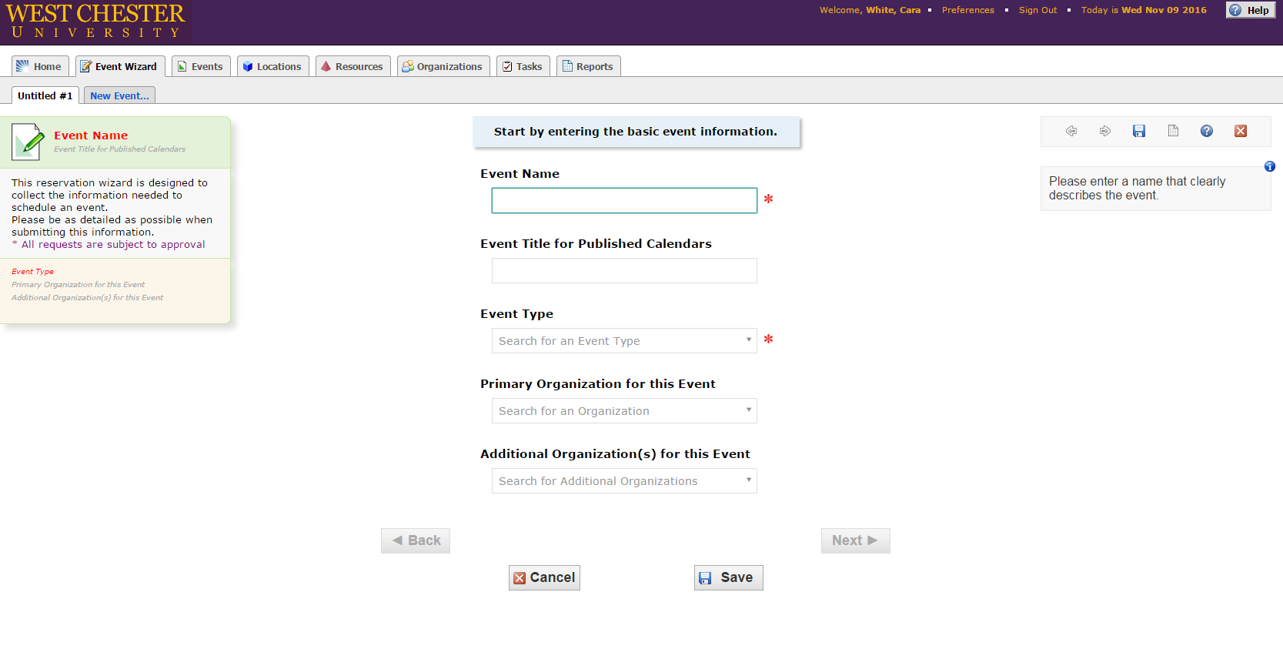
Reserving Space
25 Live
Organization Designee
Event Type
Reservation Process
Space Options

Slide 7
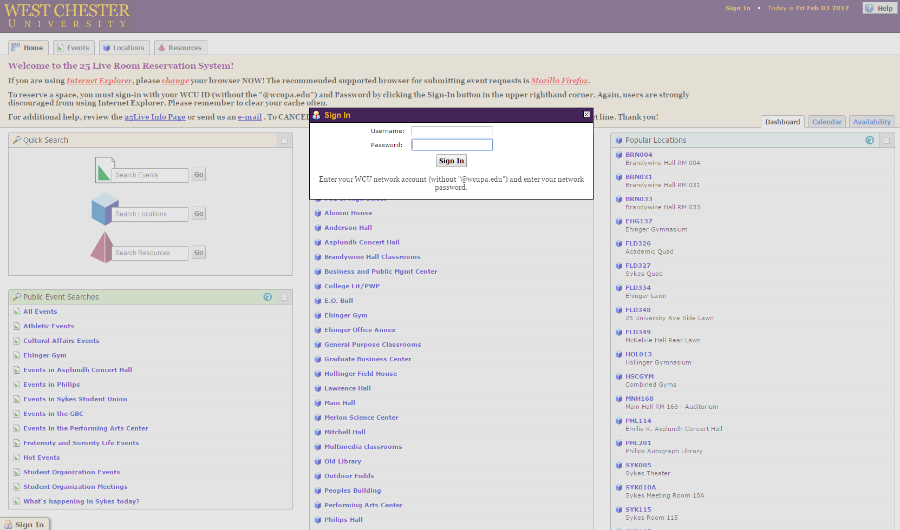
Reserving Space
25live.collegenet.com/wcupa/

Slide 8
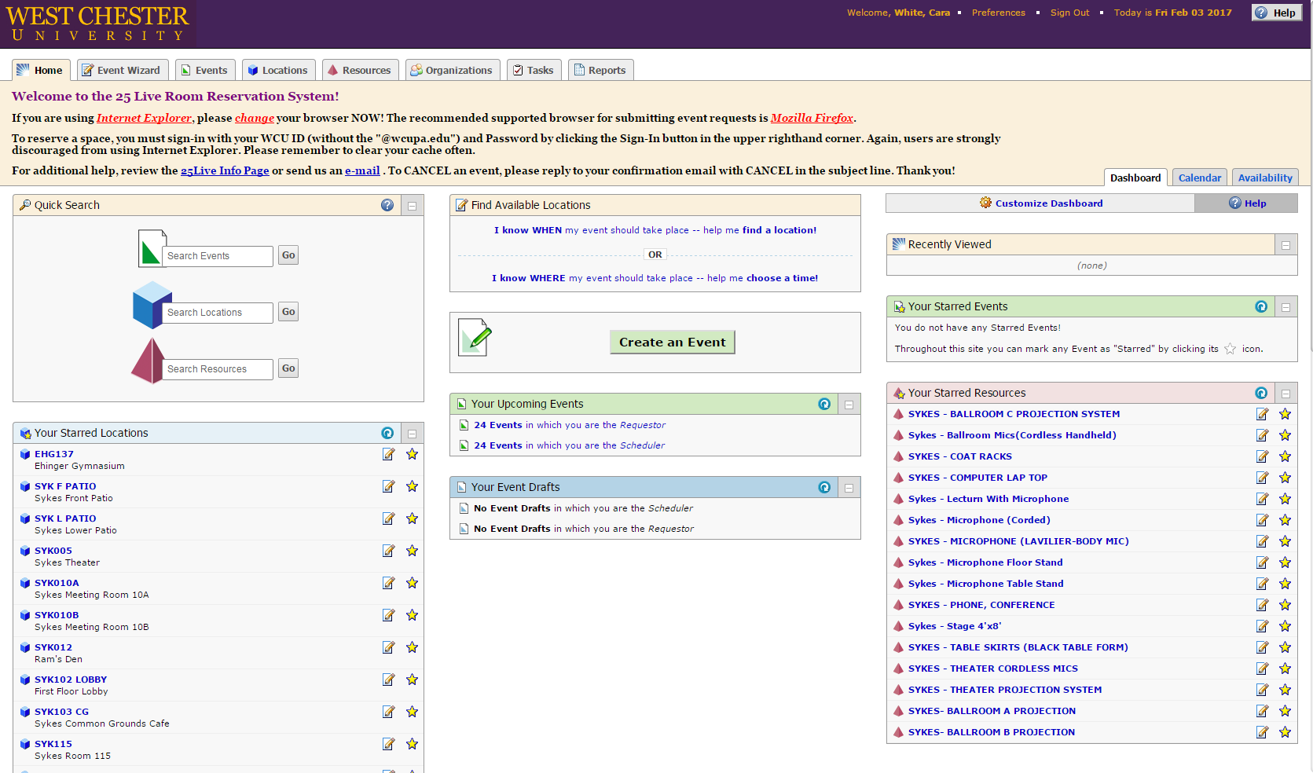
Reserving Space

Slide 9
Reserving Space
Click through Prompts
Building Codes:
Sykes = SYK
Ehinger = EHG
Main Hall = MNH
Outdoor Fields/Quads = FLD

Slide 10
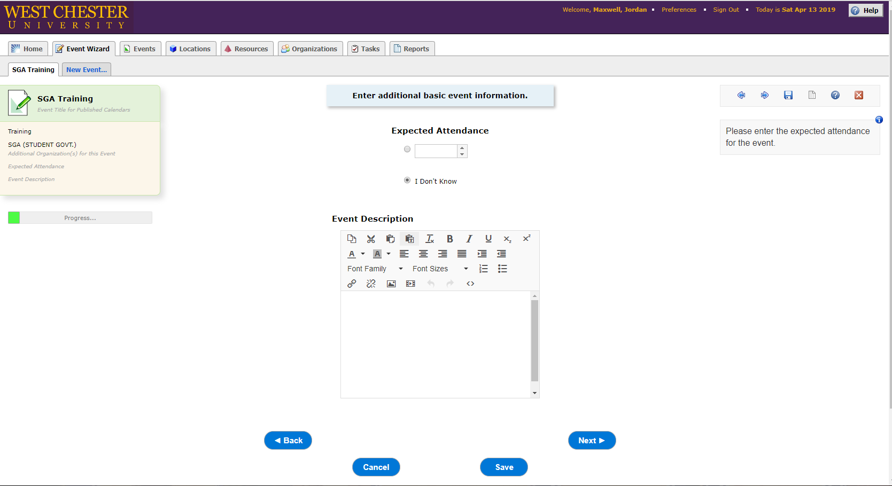
Reserving Space
Expected Attendance

Slide 11
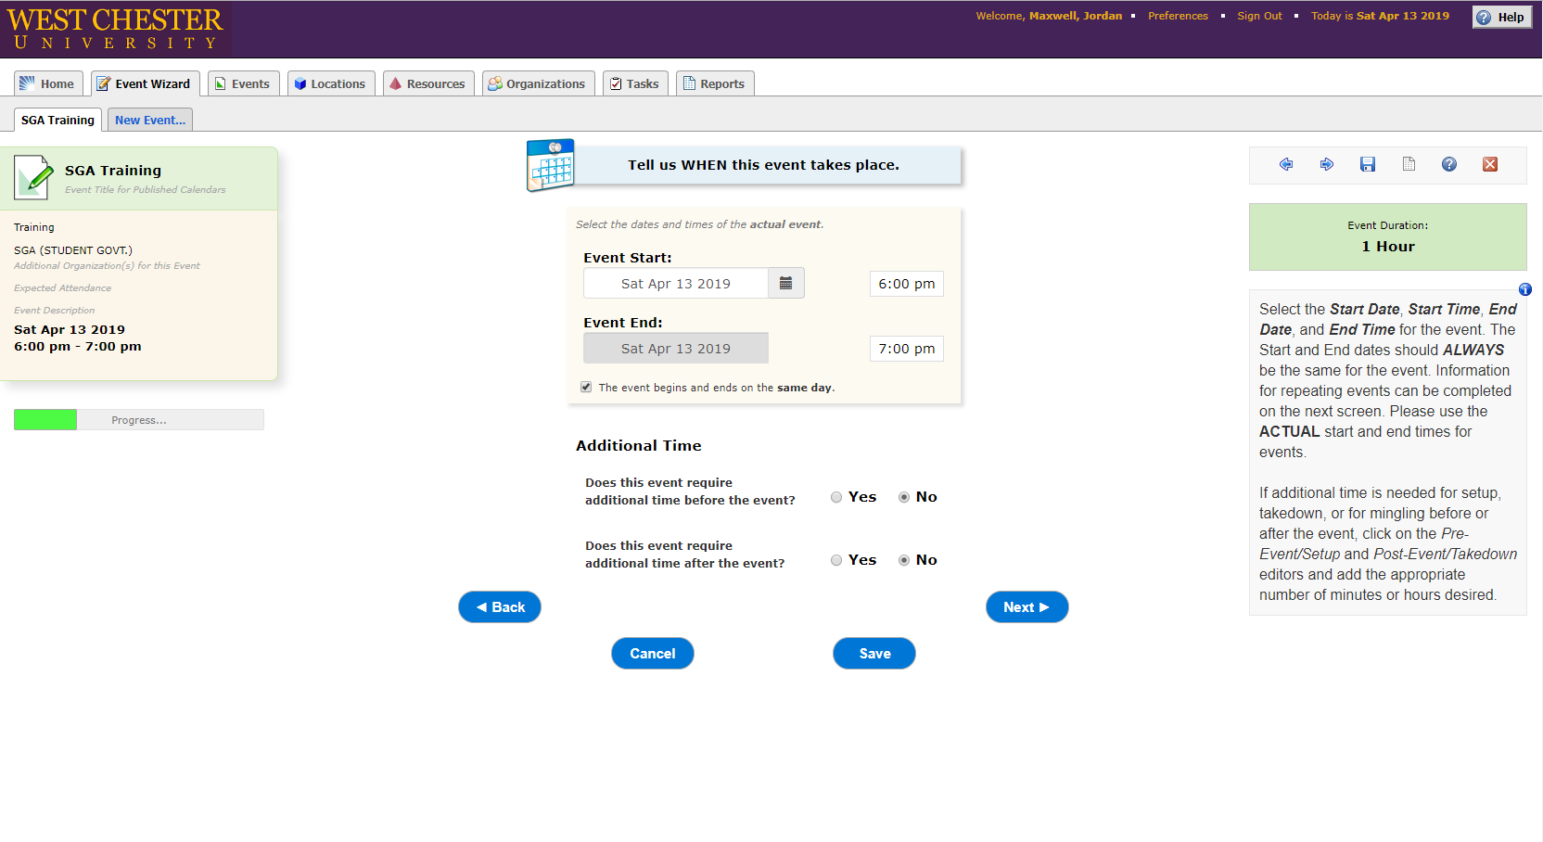
Reserving Space
Event Time(s)

Slide 12
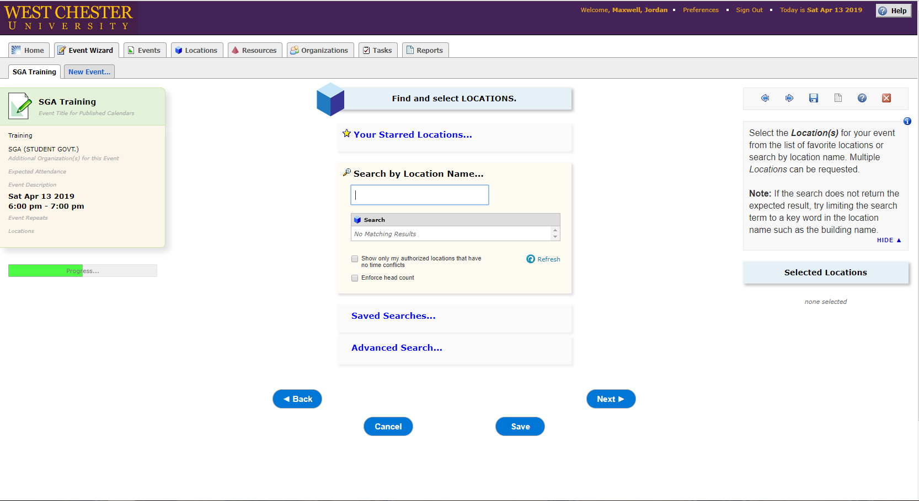
Reserving Space
Locations
Building Codes:
Sykes = SYK
Ehinger = EHG
Main Hall = MNH
Outdoor Fields/Quads = FLD

Slide 13
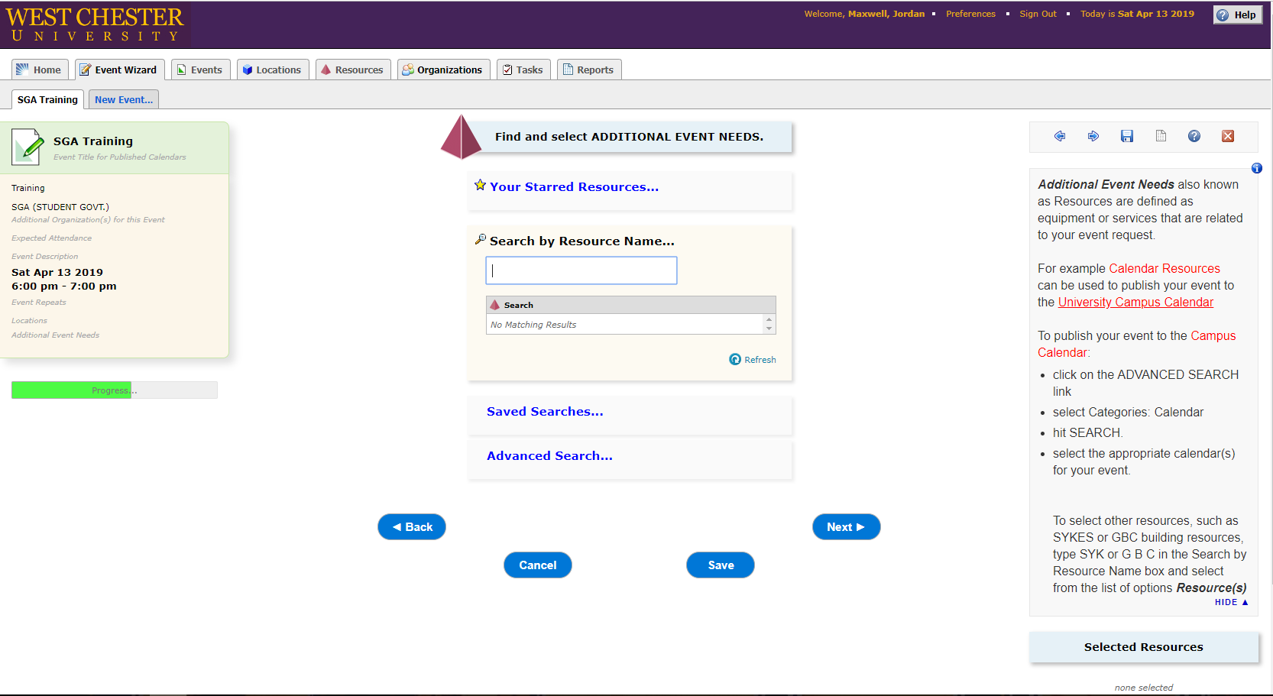
Reserving Space
Resources
Tables
Microphones
Laptop
Up lights

Slide 14
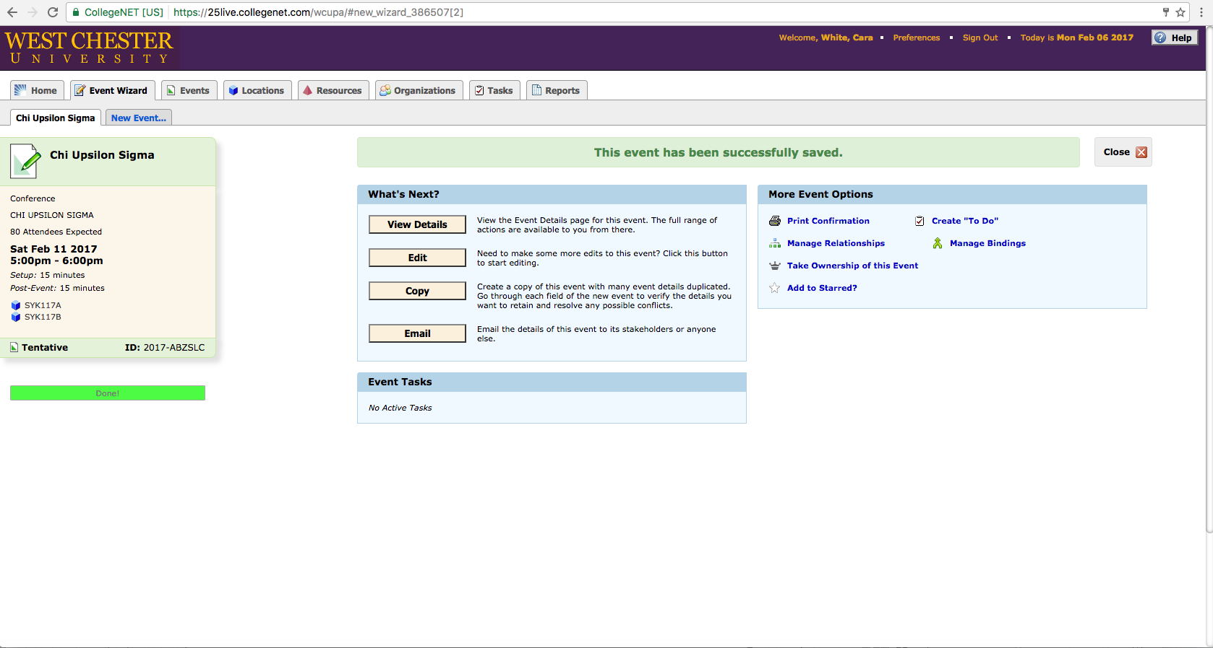
Reserving Space
Submitted Reservations
Reference Code
Email Yourself

Slide 15
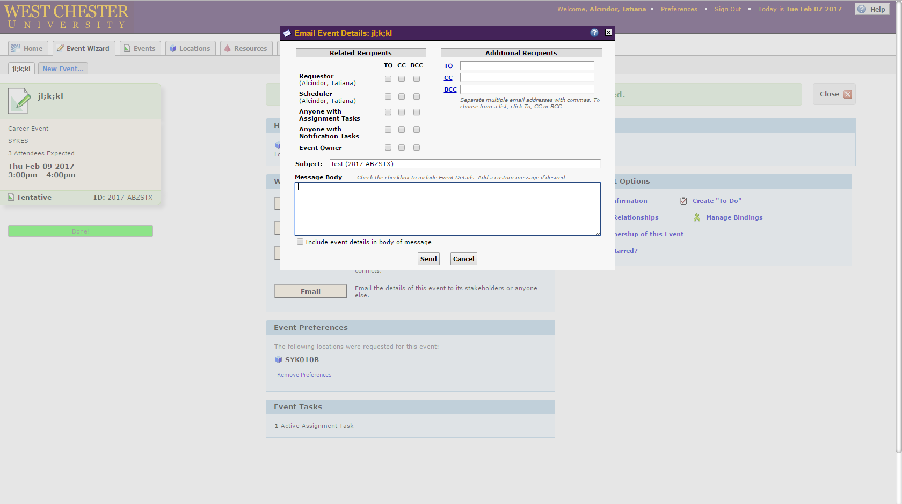
Reserving Space
Email Yourself to maintain record, and reference event
Organization Designee
Programmer/Event Coordinator
Transitioning Officers

Slide 16

Reserving Space
After Reservation Submitted, Client waits for Confirmation.

Slide 17

Processing Requests

Slide 18

Processing Requests
Management of Spaces
Sykes, Patios, Outdoor Space/5k Routes – Sykes Admin
Academic Buildings – Space Management
Recreation Spaces (Ehinger/practice fields) – Sykes Admin/Rec Services
Swope Music Building – College of Arts & Humanities
Asplundh – Venue Management
Athletic Spaces (Hollinger) – Athletics

Slide 19
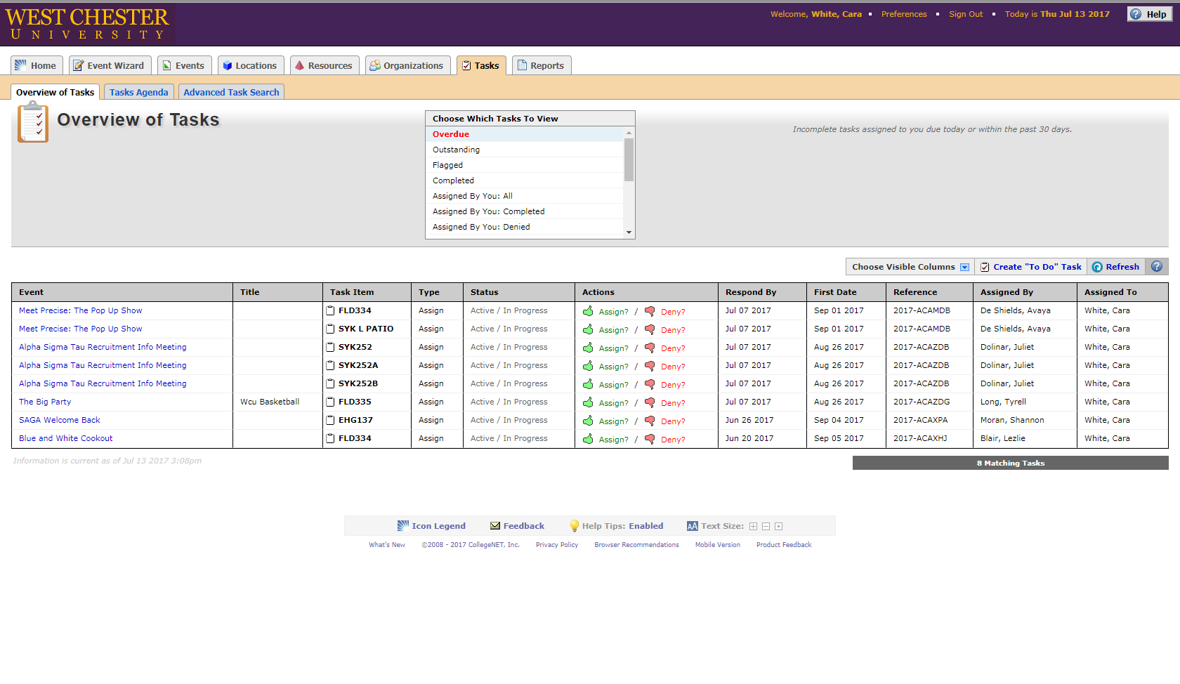
Processing Requests
Special Events
5ks or Races
Outdoor Events
Dances/Parties
Fundraisers
These Events Require Meetings with Assistant Director
At minimum 2 weeks before event date

Slide 20
Processing Requests
Based on reservation triggers, the following may happen:
An in-person meeting may be scheduled.
We may work with the group through email
No further action may be needed. We may just be able to confirm the event.
*** Events that do not “trigger” a meeting or email conversation
will go to YOU to manage!

Slide 21
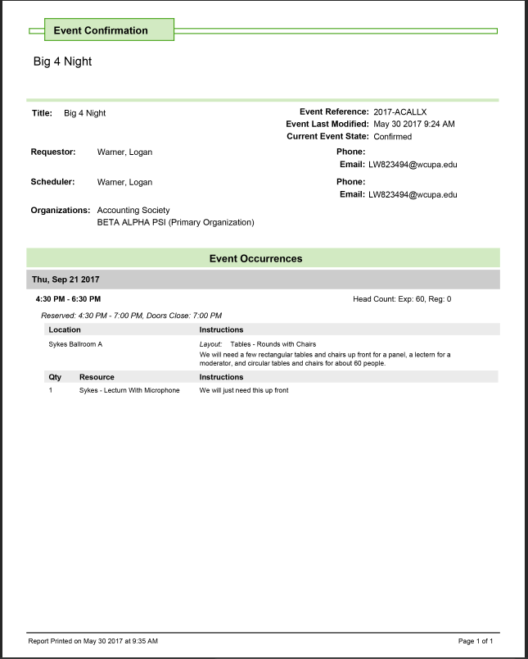

Processing Requests
Confirmation of Space
Space is not confirmed until client receives confirmation email from Administrator

Slide 22
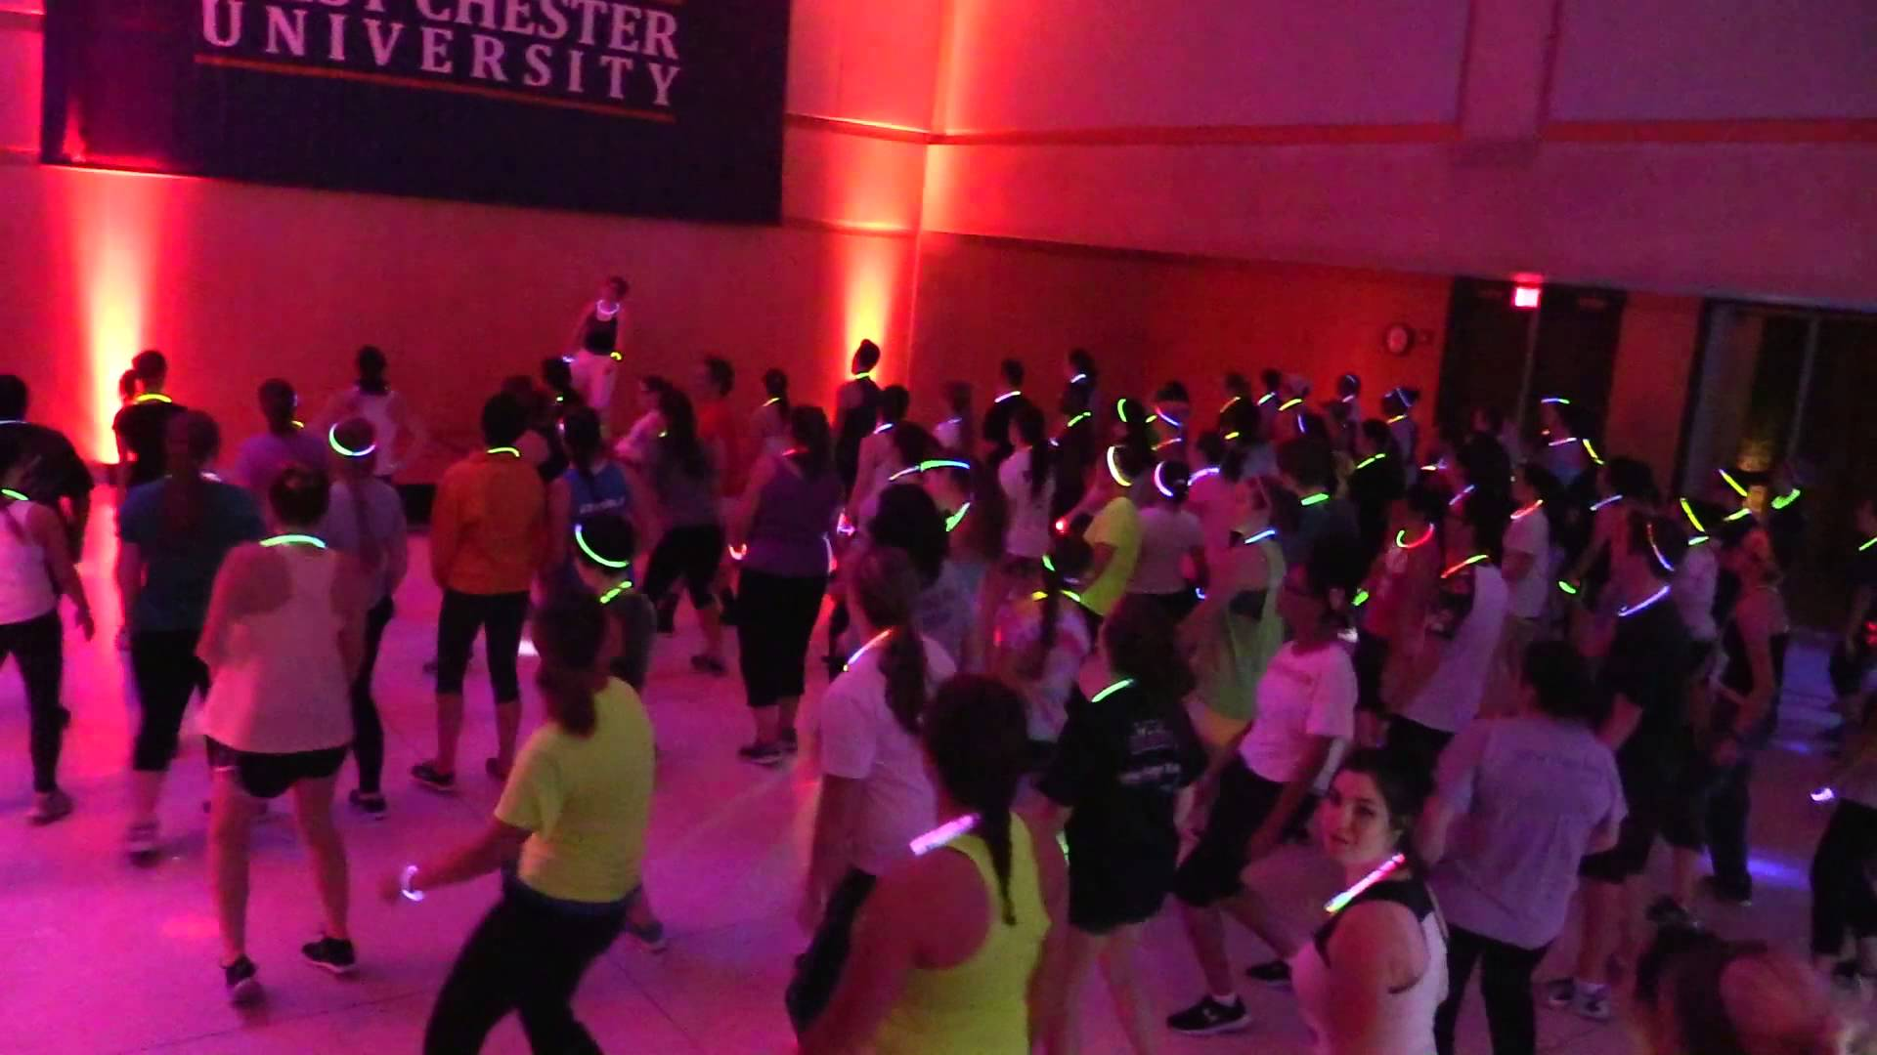
LOGISTICS FOR THE PROGRAM

Slide 23
Policies Related to Program Logistics
Food at Events
Depending on Space food may or may not be permitted
All events on campus are required to use ARAMARK/New Street Catering for their programs, meetings, and events.
Options are available for outside, but you must obtain waiver and permission from catering.
Bake sales and pretzel sales are exempt. For all food distribution, group must wear gloves.
Outside food is granted for closed/private events. Approval comes from Sykes Administration.
Groups may never serve food to the public they have cooked themselves. Private meeting “potlucks” are not included- it’s only when anyone can walk up and eat or purchase food.

Slide 24
Policies Related to Program Logistics
Public Safety
May be required at the event if one or more of the following criteria is met.
There is a potential for non-WCU students to be present,
An admission fee is charged/anticipation of large quantity of money on site
The size of the expected crowd,
Event ends after 12 midnight,
The program was advertised off campus,
Nature of the entertainment, i.e. DJ, band, live performer, etc.

Slide 25
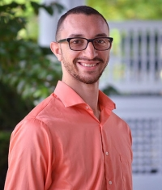
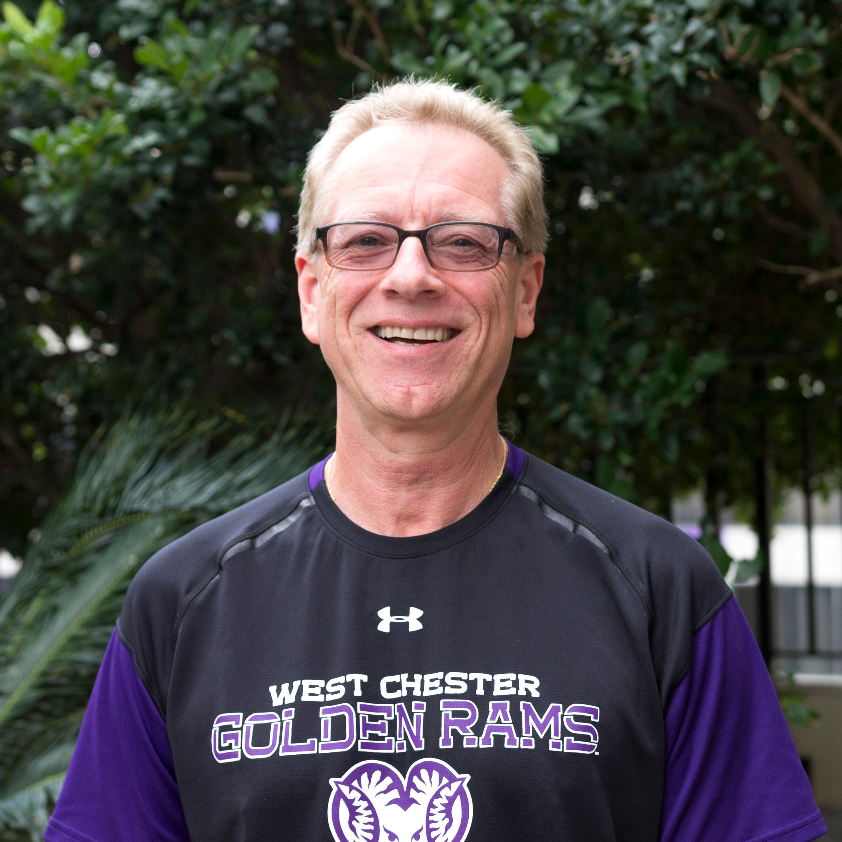
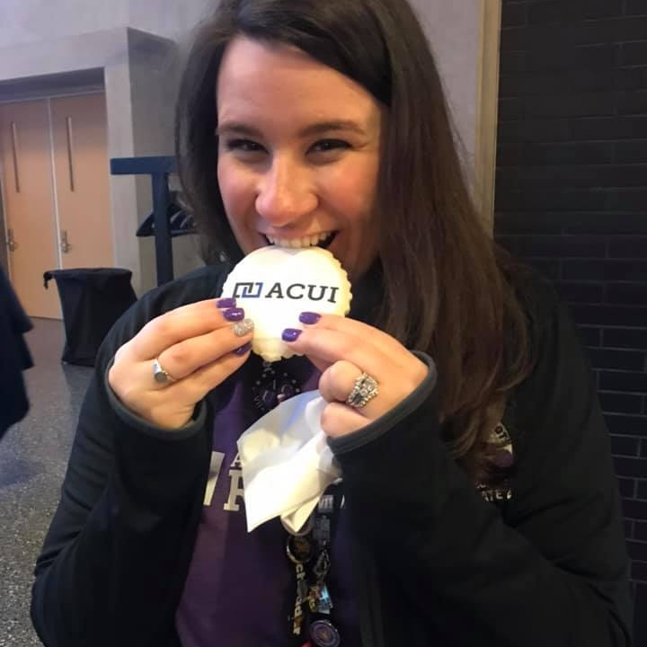
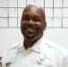
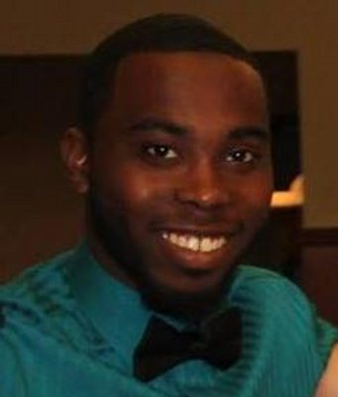
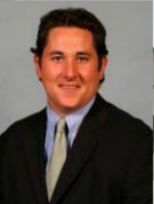
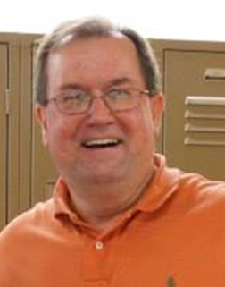
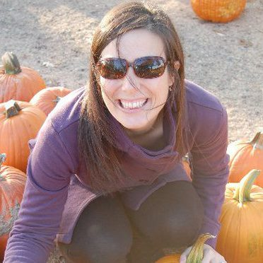
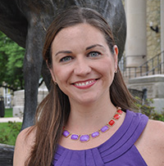
Points of Contact
Dave Timmann,
Director, Sykes Union
Jordan Maxwell
Assist. Director,
Sykes Union
Adriane Reilly,
Assoc. Director,
Sykes Union
NaQuan Redd
Assist. Director
Sykes Union
Lt. Ray Stevenson
Public Safety
Charlie Warner
Director,
Student Leadership &
Involvement
Jennifer Yost
Assist. Director,
Student Leadership &
Involvement
Cara Jenkins-Sullivan
Director,
Fraternity & Sorority Life
Mike Reno
Assist. Director,
Campus Recreation

